Slide 1
EKF&NAVSAT vs Lio-sam compare
EKF & NAVSAT_TRANSFORM
Lio-sam
발표자 : 이담

Slide 2
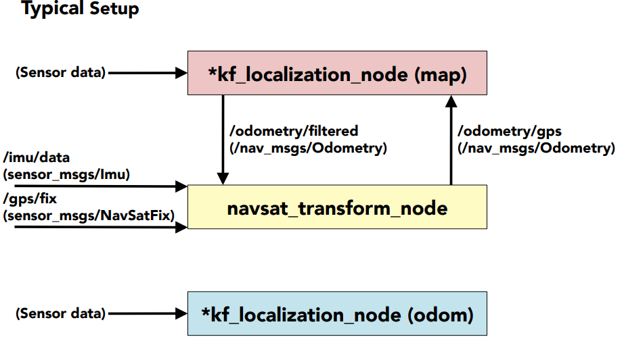
Drone_localization typical setup (rqt_topic)
/velodyne_lidar/fix (sensor_msgs/NavSatFix)
/velodyne_lidar/imu (sensor_msgs/imu)
/odometry/navsat (nav_msgs/Odometry)
/odometry/filtered (nav_smgs/Odometry)
/lio_sam/mapping/odometry (nav_msgs/Odometry)

Slide 3
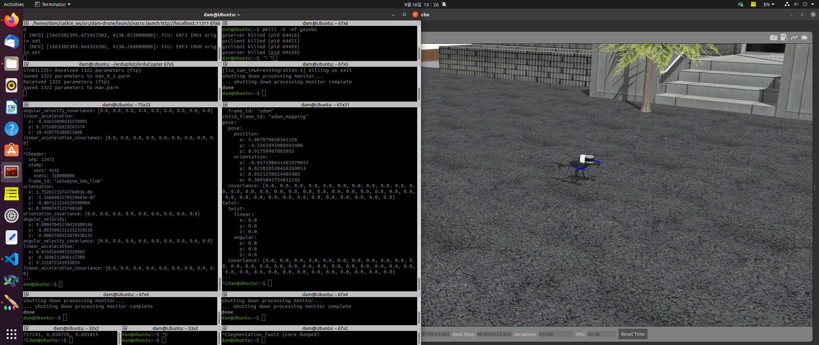
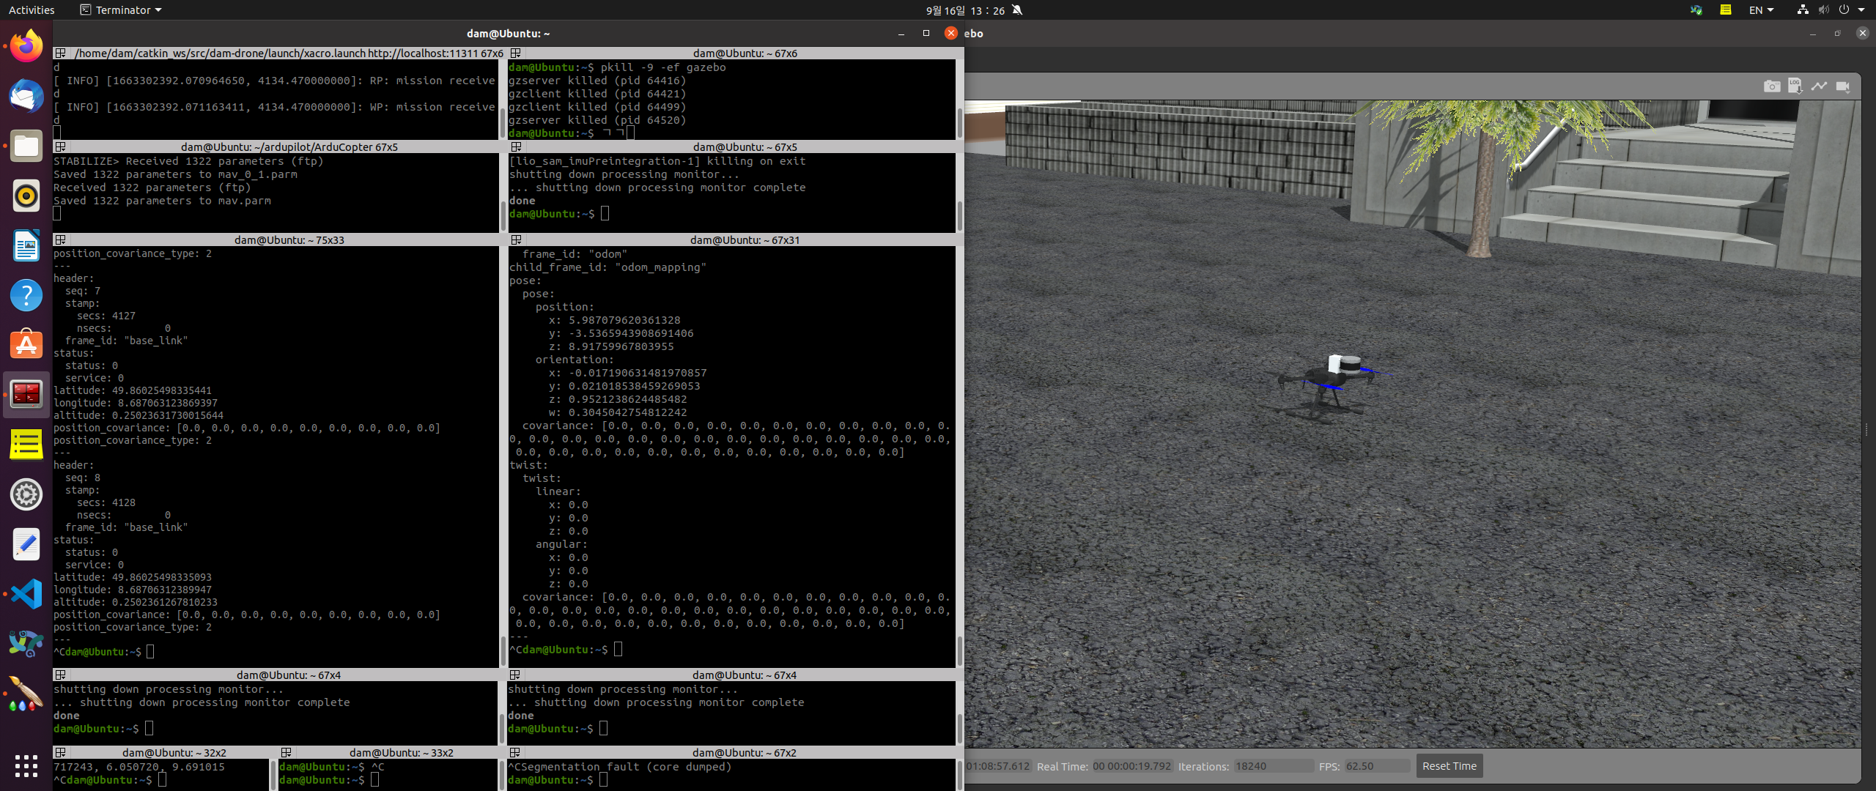
GPS Topic name : rostopic echo /velodyne_lidar/fix
IMU Topic name : rostopic echo /velodyne_lidar/imu

Slide 4
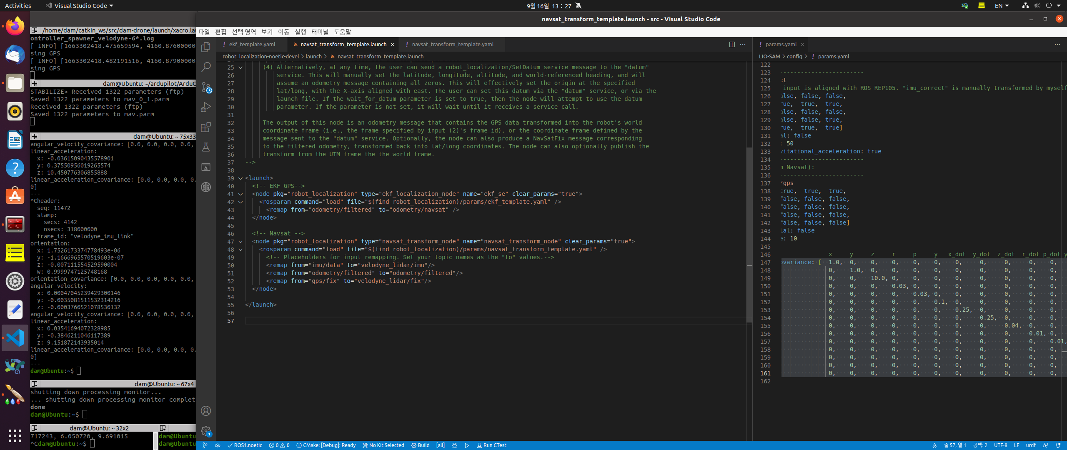
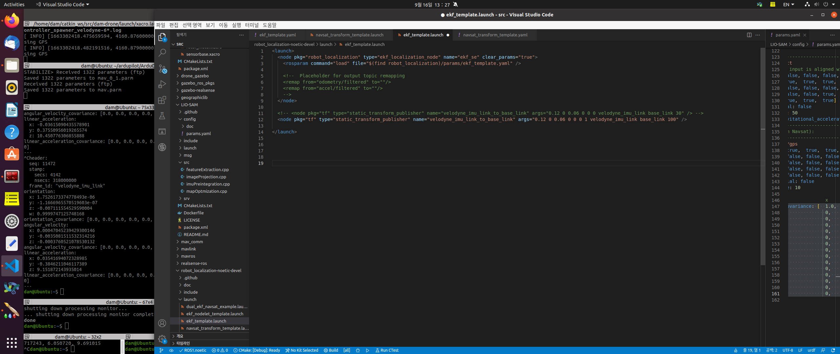
NAVSAT launch file
EKF launch file

Slide 5
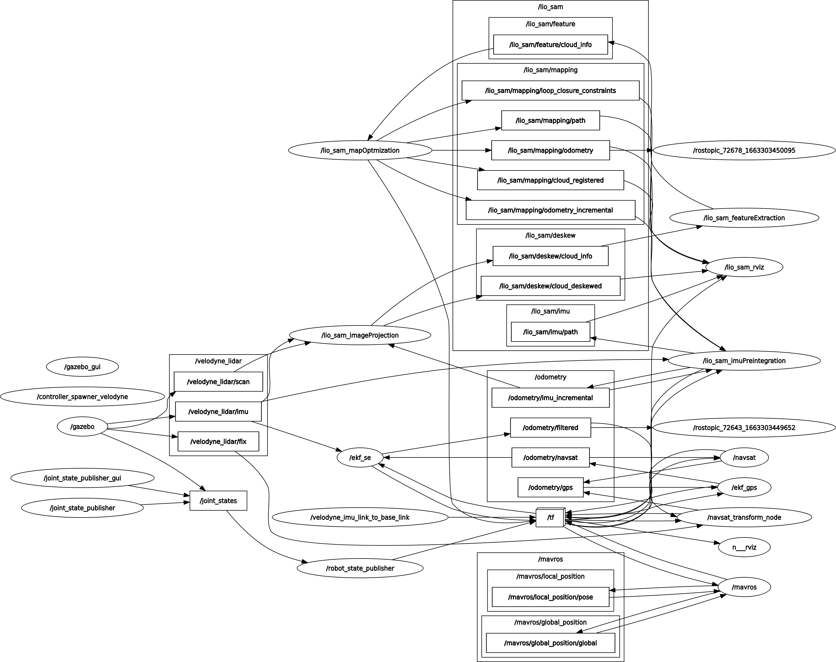
rqt graph

Slide 6
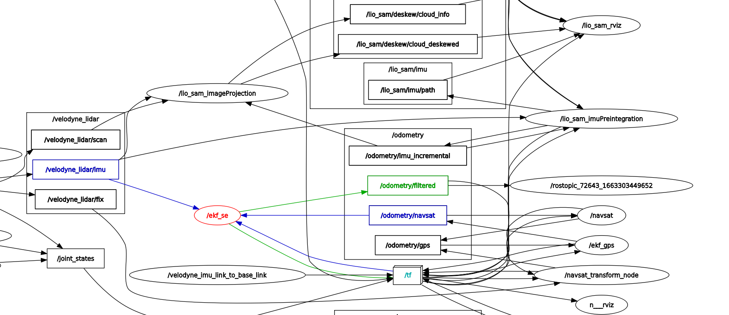
rqt graph_EKF&NAV

Slide 7
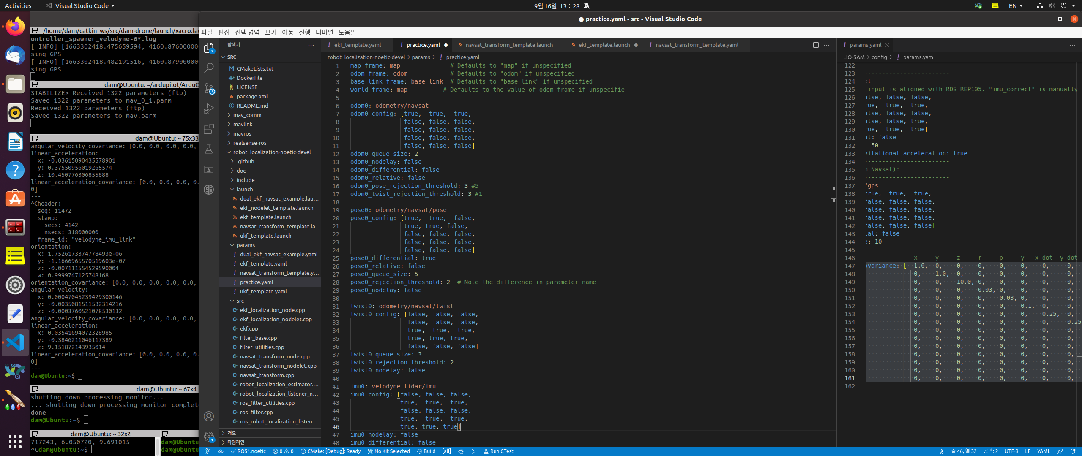
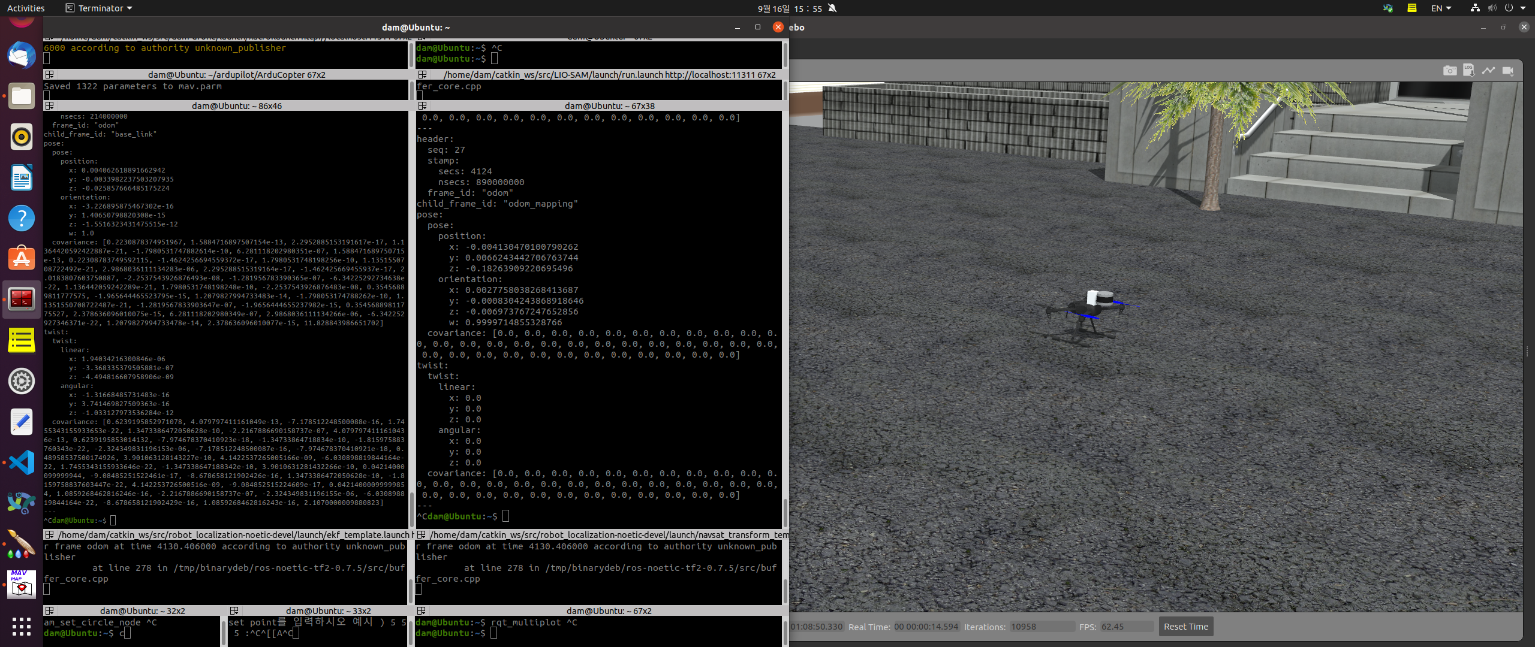
EKF_template.yaml
Odometry 관련 parameter
Odometry/navsat은 아래와 같음

Slide 8
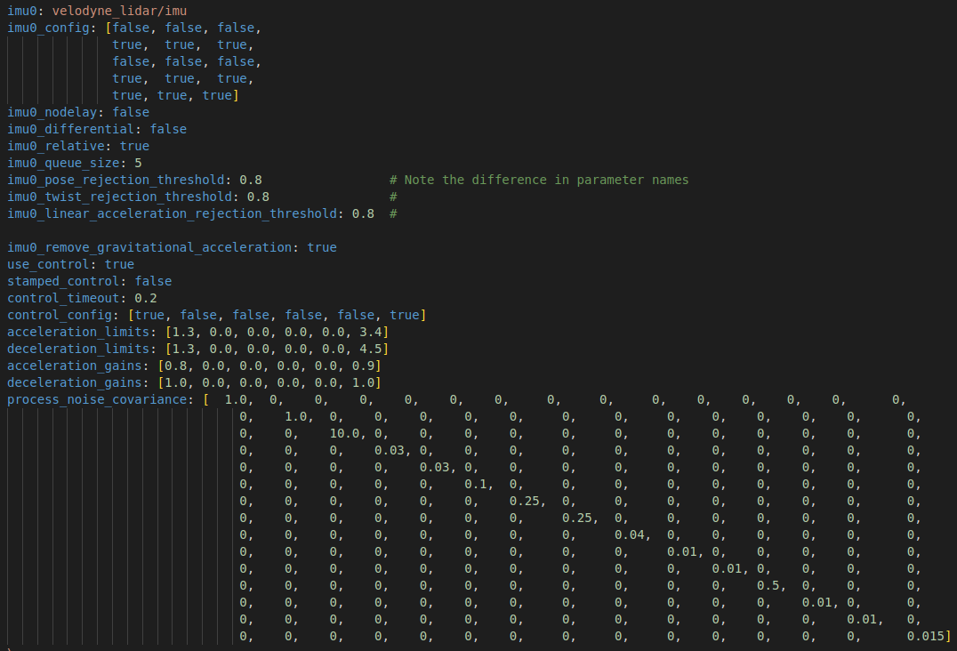

Slide 9
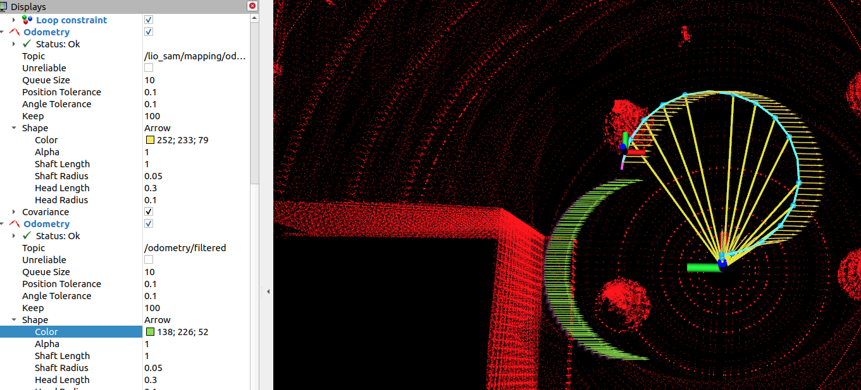
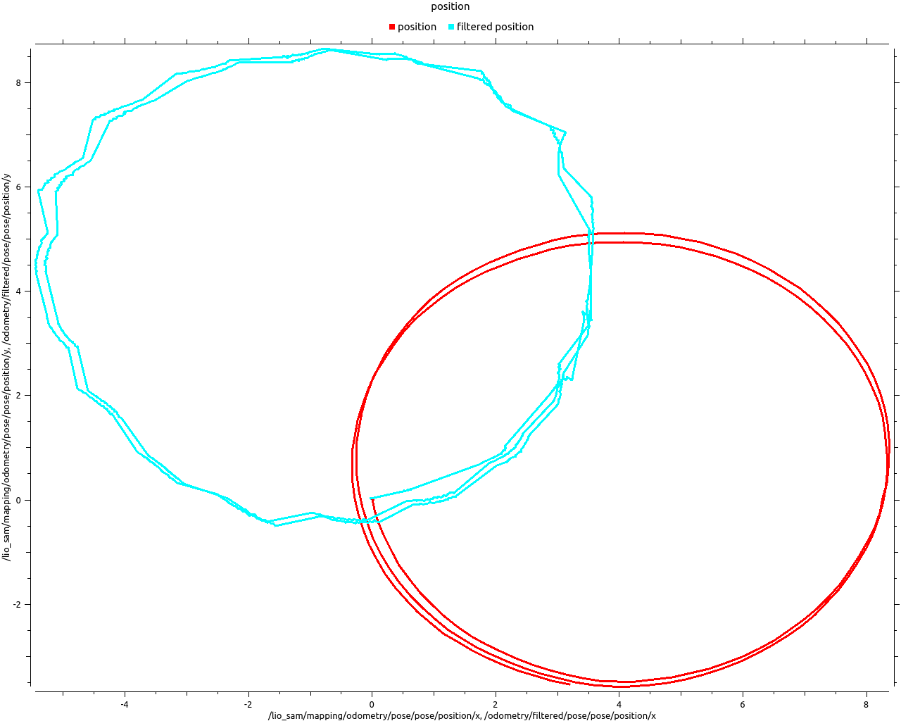
Navsat_transform_template.yaml
Yaw_offset defalt = 0
LIO-SAM transforms IMU raw data from the IMU frame to the Lidar frame : (x - forward, y - left, z - upward)
→ 즉, Lio-sam의 pose값은 y축의 기호가 반대로 나옴

Slide 10
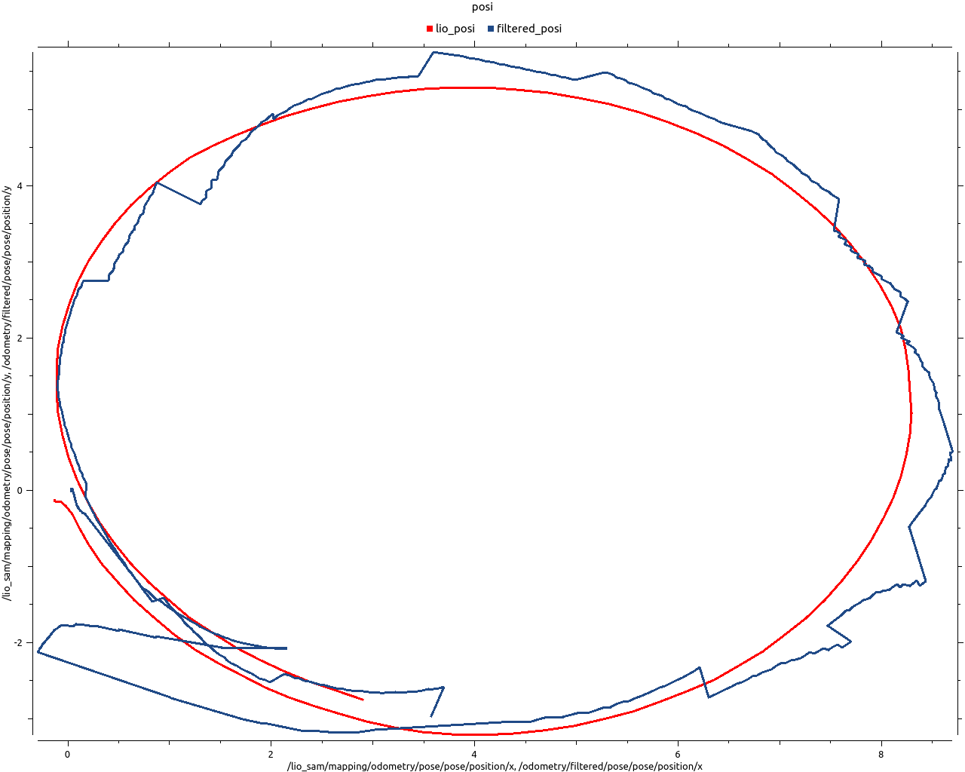
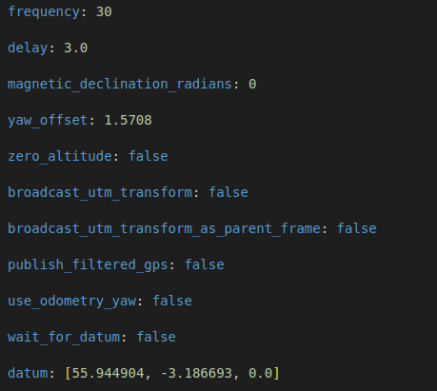
Navsat_transform_template.yaml
yaw-offset defalt unit is RADIAN
yaw를 90도 돌려, lio sam과 ekf의 pose값을 비교할 수 있음

Slide 11
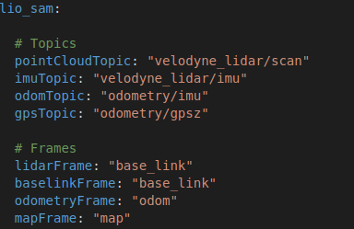
Lio-sam
Config file topic 수정, config/params.yaml
In simulation, LIDAR and imu value

Slide 12
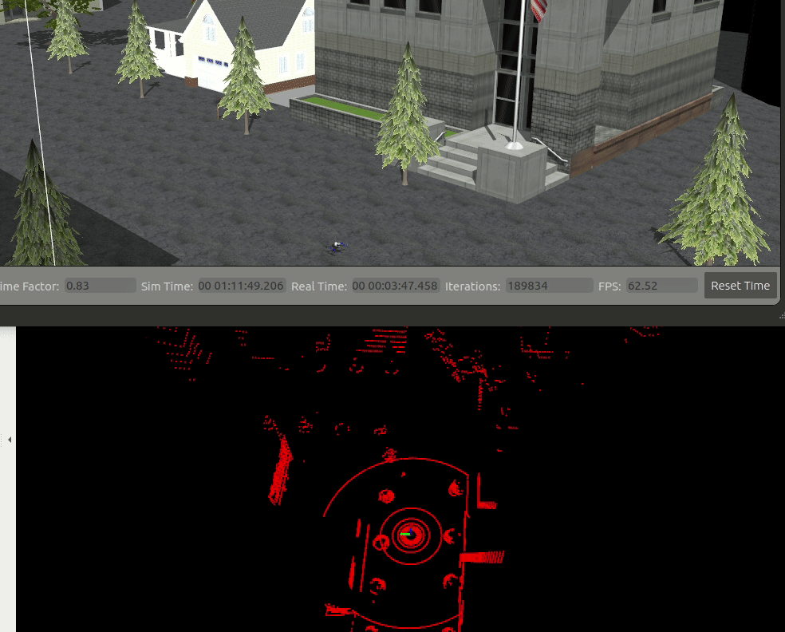
Lio-sam & gazebo simulation 실행

Slide 13
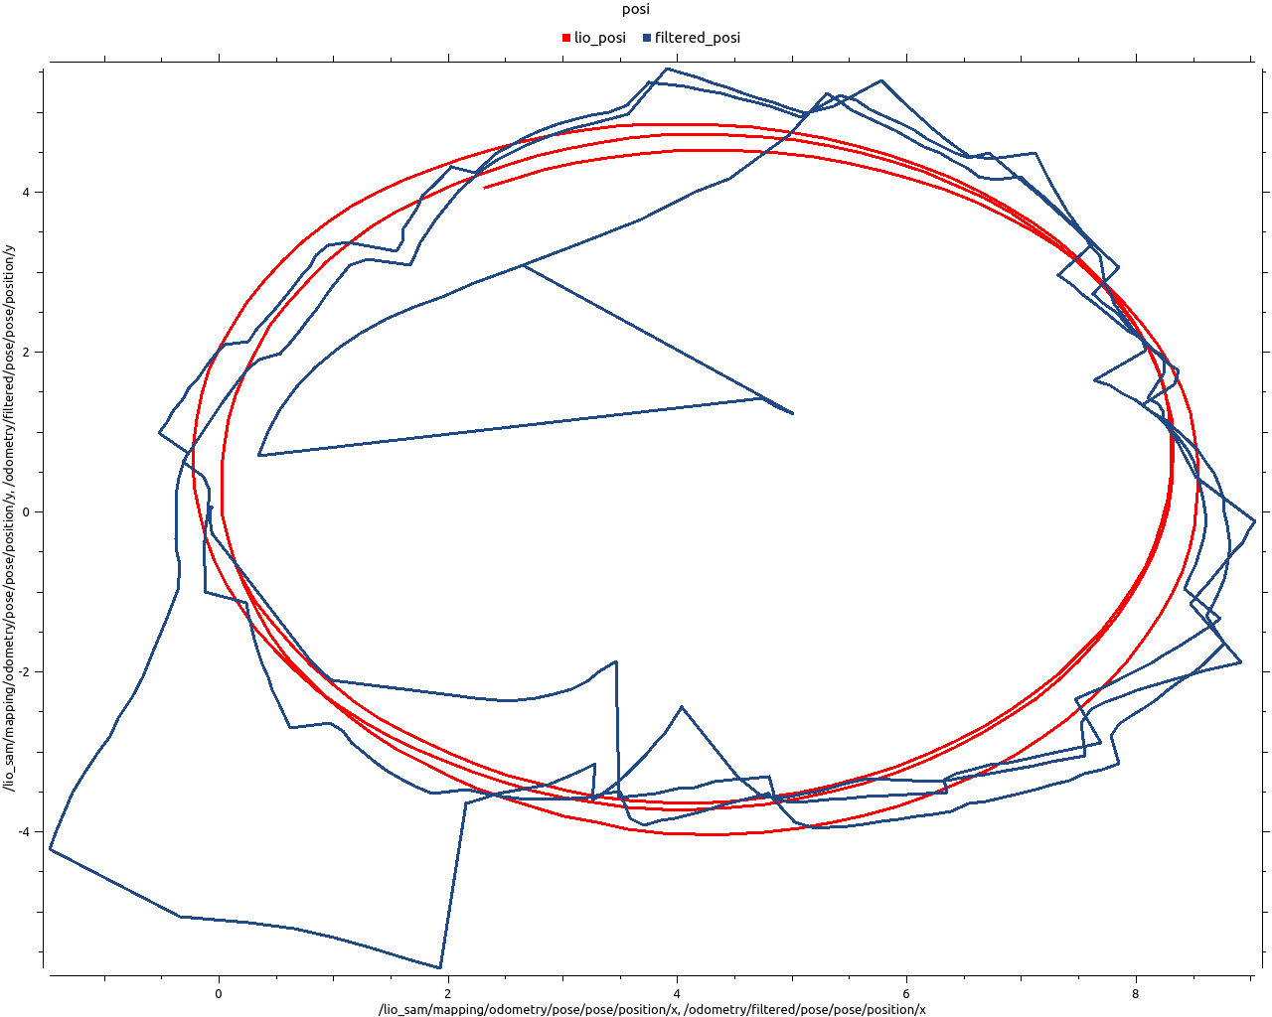
1. EKF Parameter 수정
Frequency defalt 30 > 10
불안정한 값을 자주 받아서 그런듯 함
Pic. default graph
Pic. Modify frequency graph

Slide 14
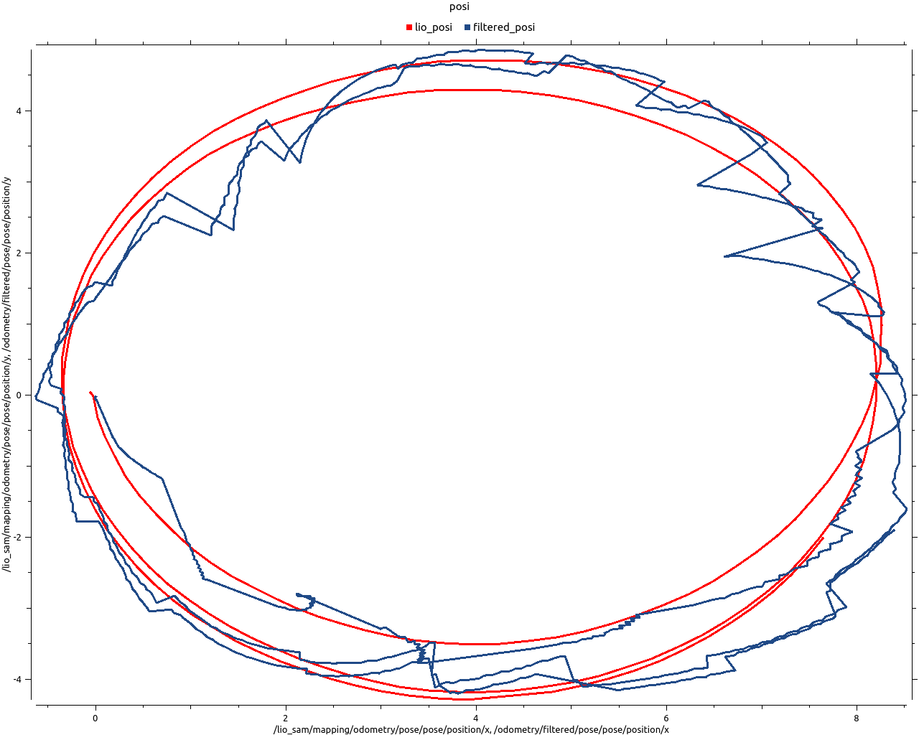
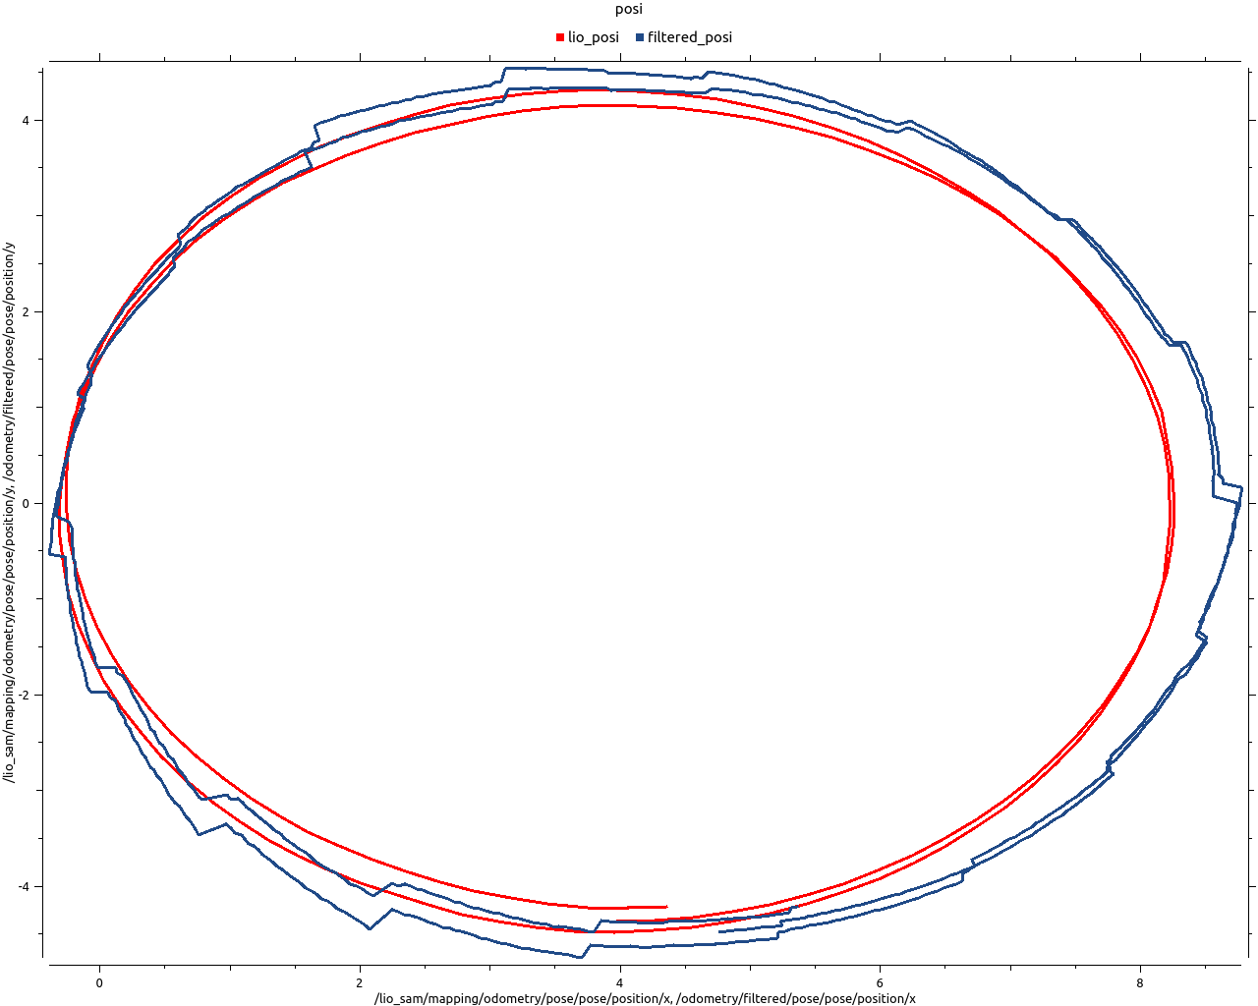
2. EKF Parameter 수정
odom, imu config 및 odom pose, twist 추가
odometry > pose(pose, orientation) / twist(linear, angular)
imu > orientation, angular velocity, linear accelation
Pic. first graph
Pic. later graph

Slide 15
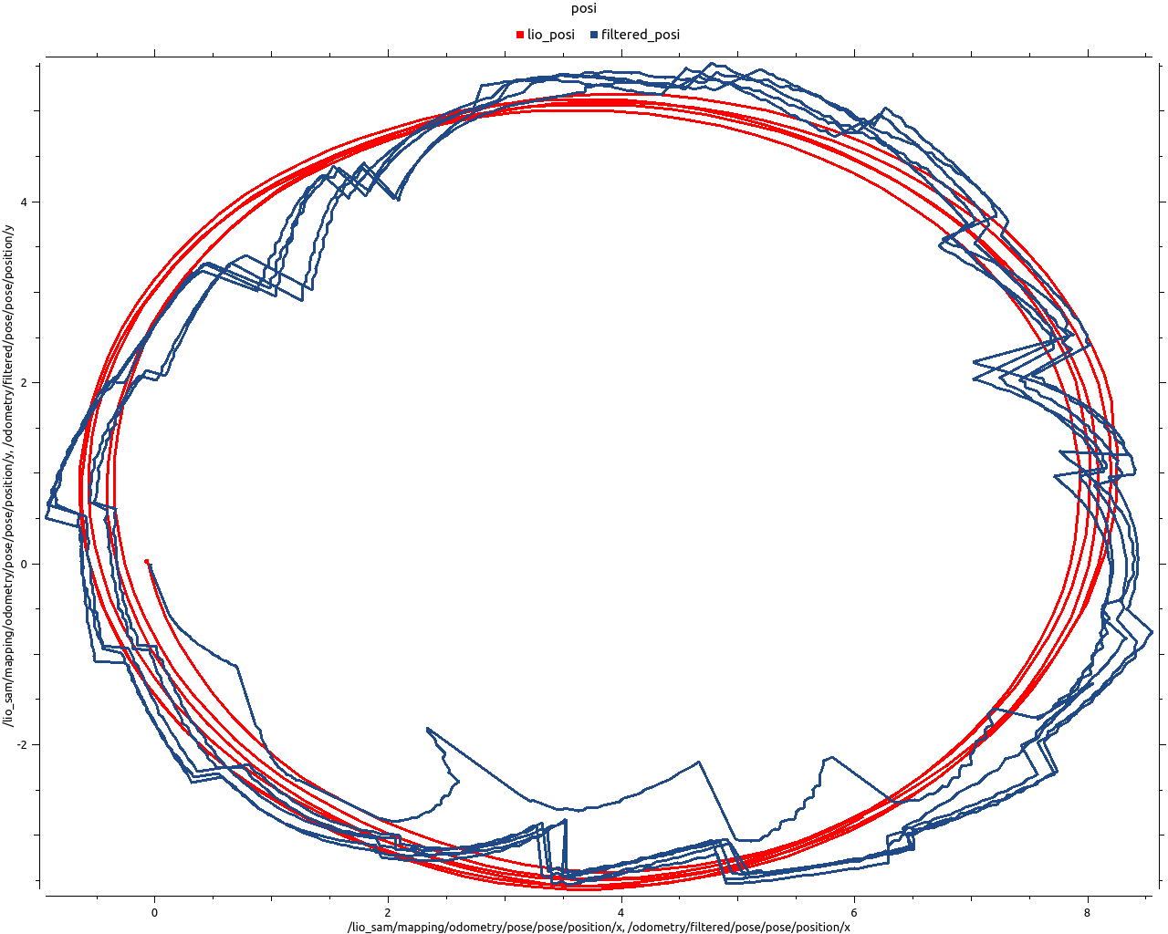
3. EKF Parameter 수정
World frame defalt odom > map
GPS는 이산적이고 절대적인 값이므로 world frame : map
Pic. world frame map graph

Slide 16
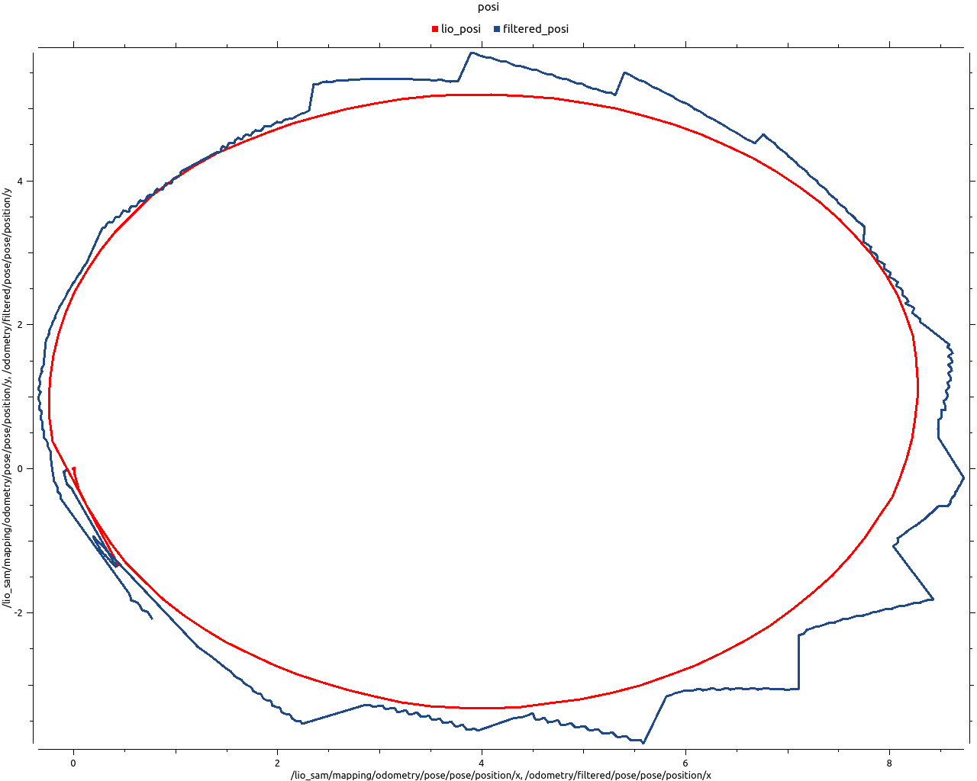
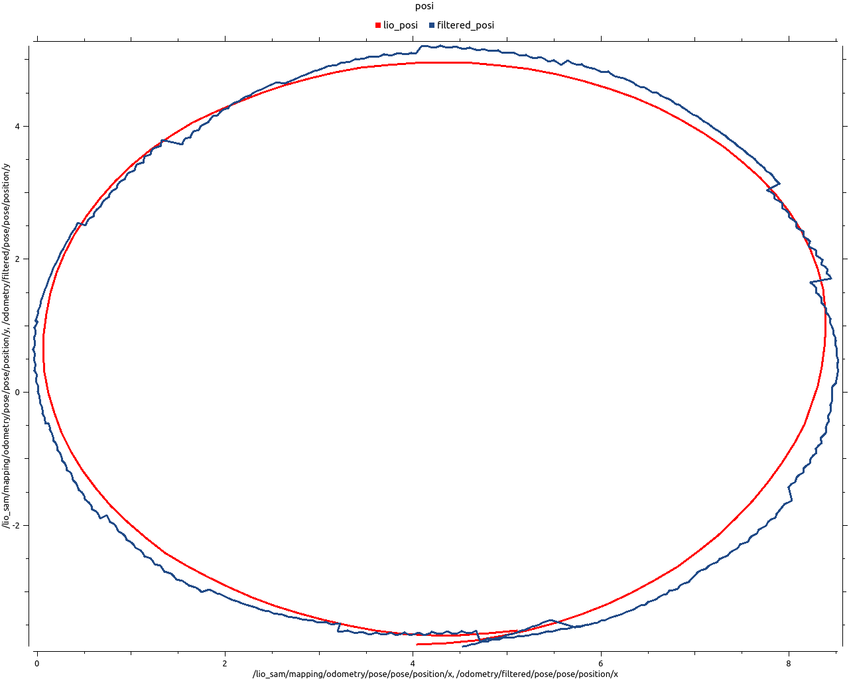
4. EKF Parameter 수정
Process_noise_covariance 수정 > Lio-sam covariance
Pic. first graph
Pic. later graph

Slide 17
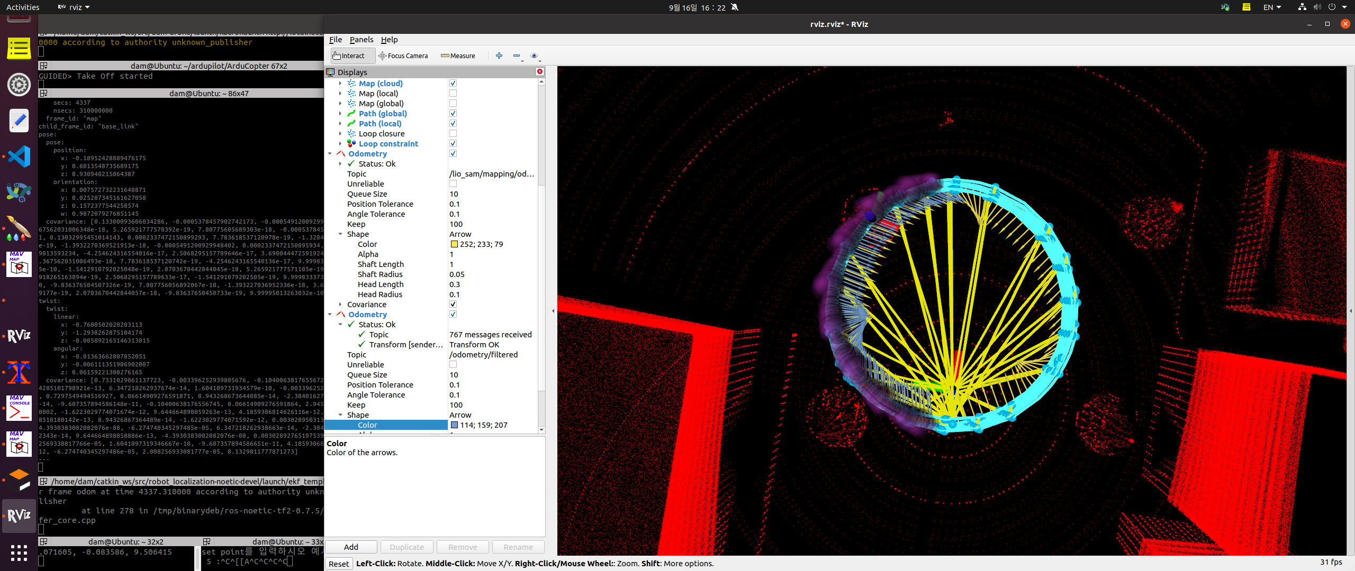
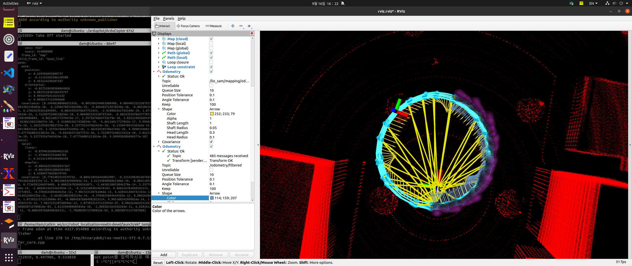
4. EKF Parameter 수정 – 최종
Frequency(30), world frame(map), odom/imu config, odom pose/twist, process noise covariance
Yellow arrow : lio sam / Blue arros : filtered odometry / Purple circle : ekf covariance
Yaw 돌려서 축
이상하게 보이는 것
Pic. compare graph_final

Slide 18
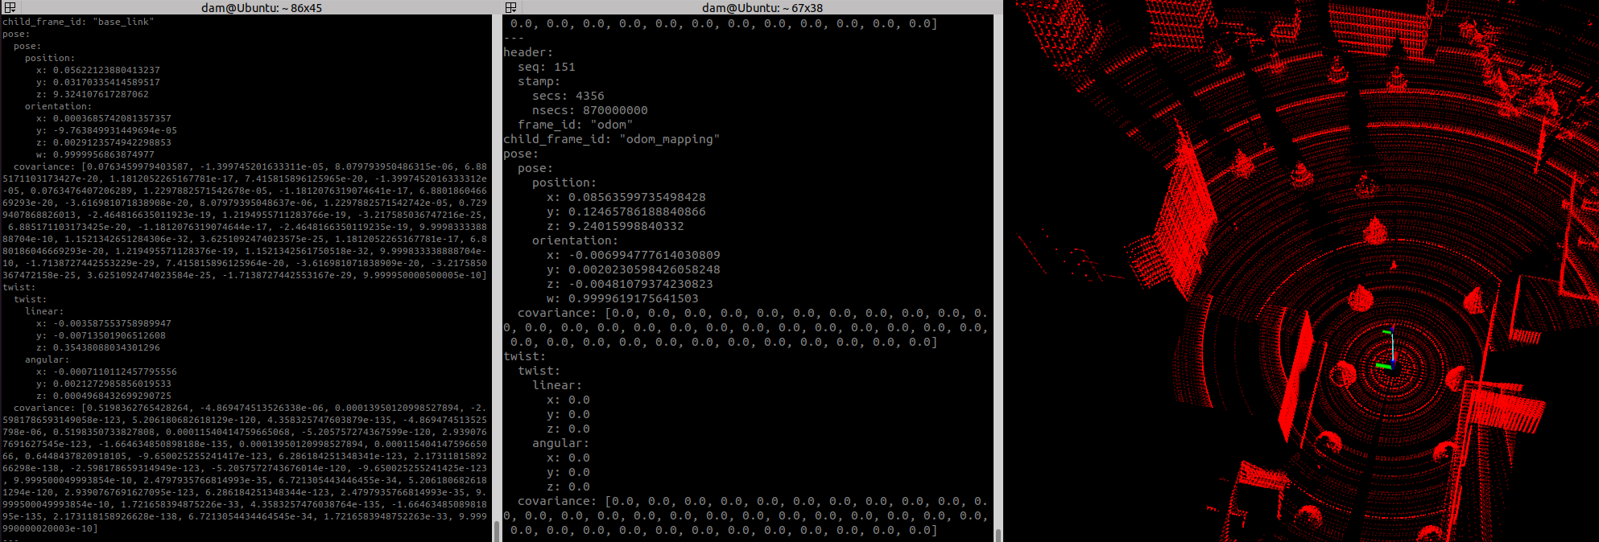
Position set (0, 0, 10)
odometry/filtered와 lio_sam/mapping/odometry 비교
Pic. Compare position

Slide 19
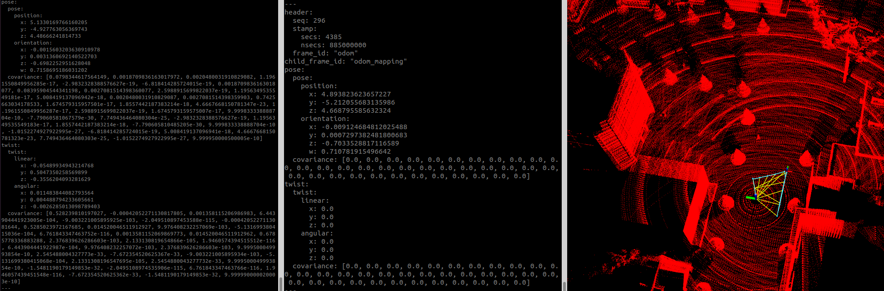
Position set (5, 5, 5)
odometry/filtered와 lio_sam/mapping/odometry 비교
Pic. Compare position

